Slide 1
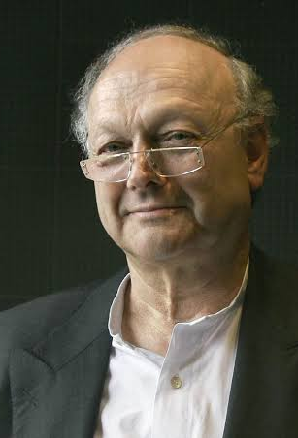
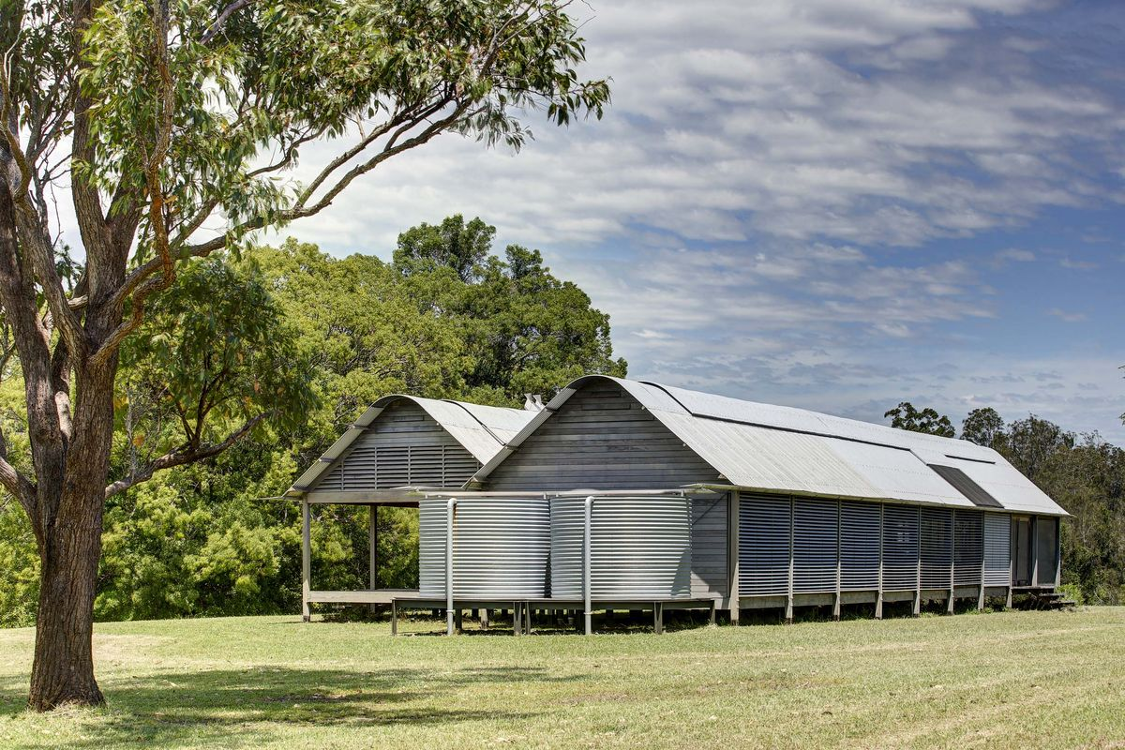
Model making process
NBC1100 Built Environment Communication
and Skills
Architect – Glenn Murcutt
Fergus Shaw - Marie Short House
David Larsson – Walsh House

Slide 2
Marie Short House - Process Model (Fergus Shaw)
Steps Involved:
1. Balsa Wood, Stanley knife, hot glue gun, and timber vinyl was purchased from Bunnings
2. The flooring was cut to size and joined together with hot glue
3. The frame was erected and cut to size. The wall and lourves where than created using the balsa wood.
4. The roofing was than created. I started off doing a pitched roof. Then I soaked a thin piece of balsa wood in water and manipulated it to curve. After leaving it to rest I screwed it on with my Mikita impact driver. The Vinyl was than placed over the top to hide the screws.
5. The decking steps and internal walls where completed.

Slide 3
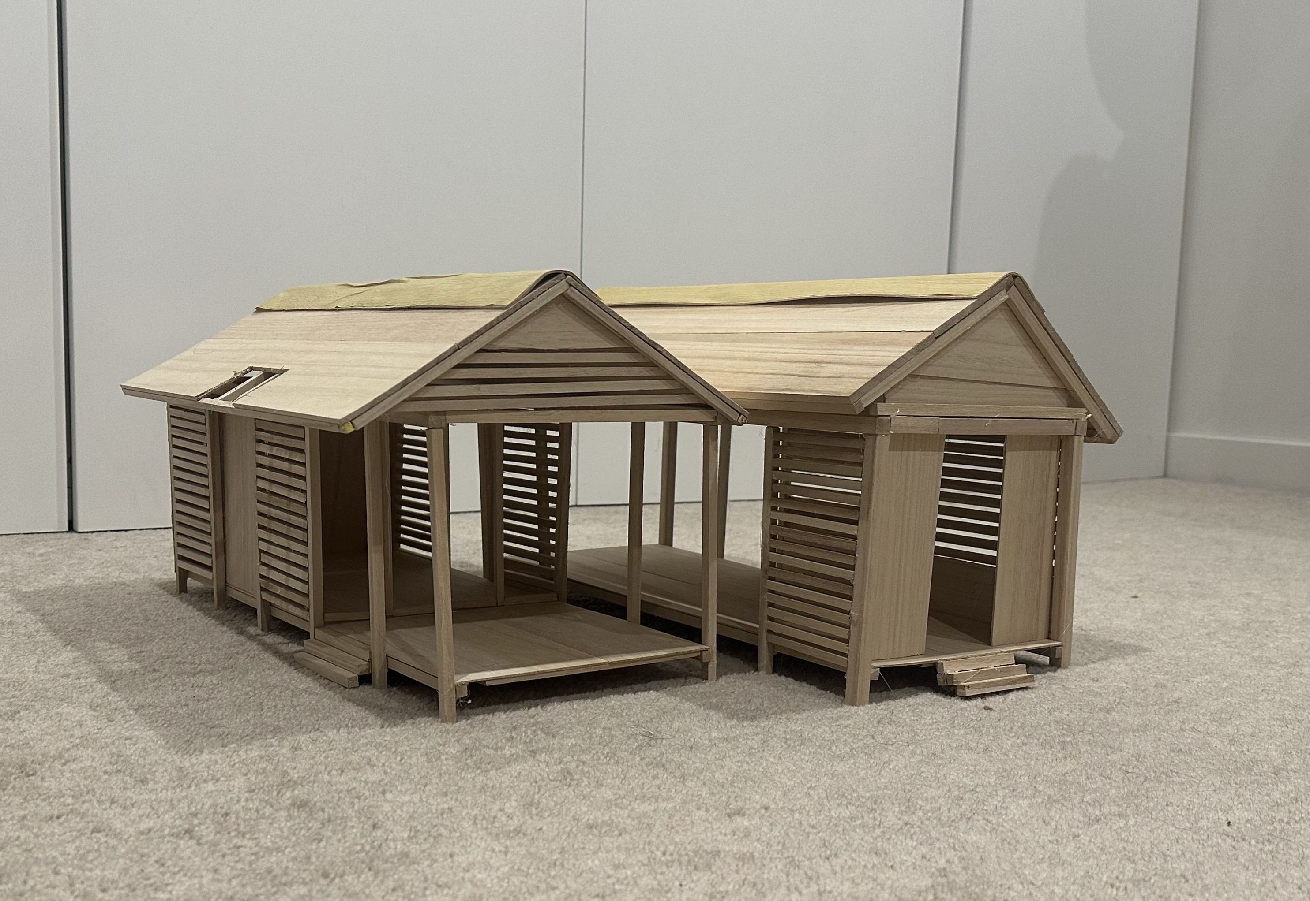
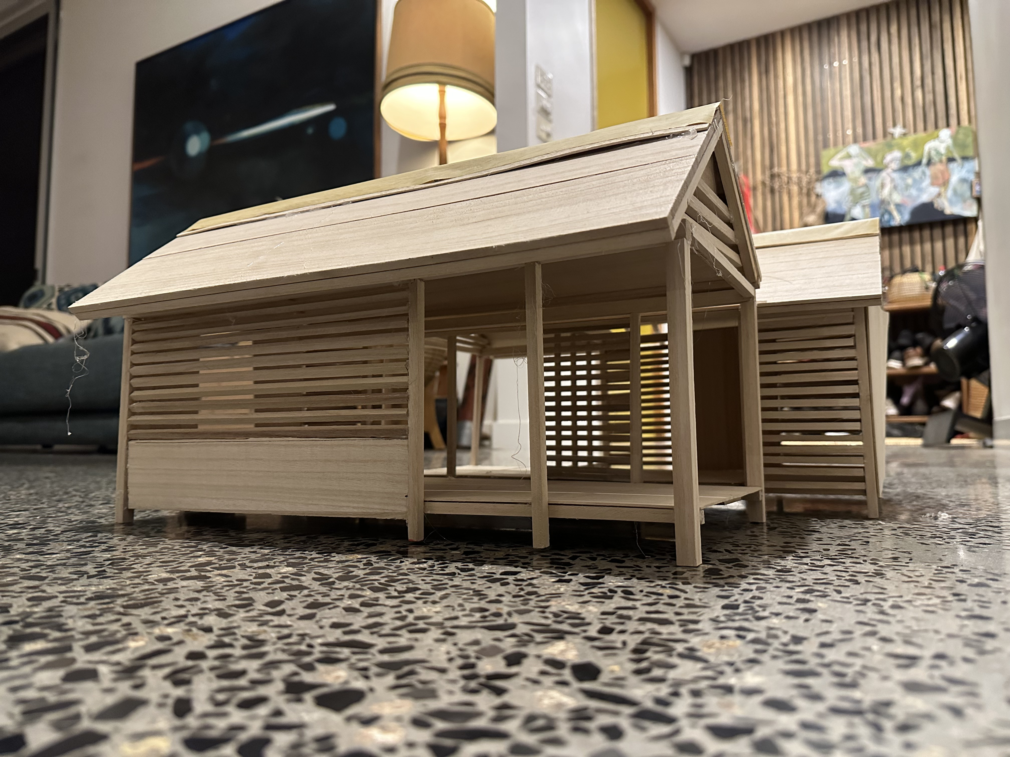
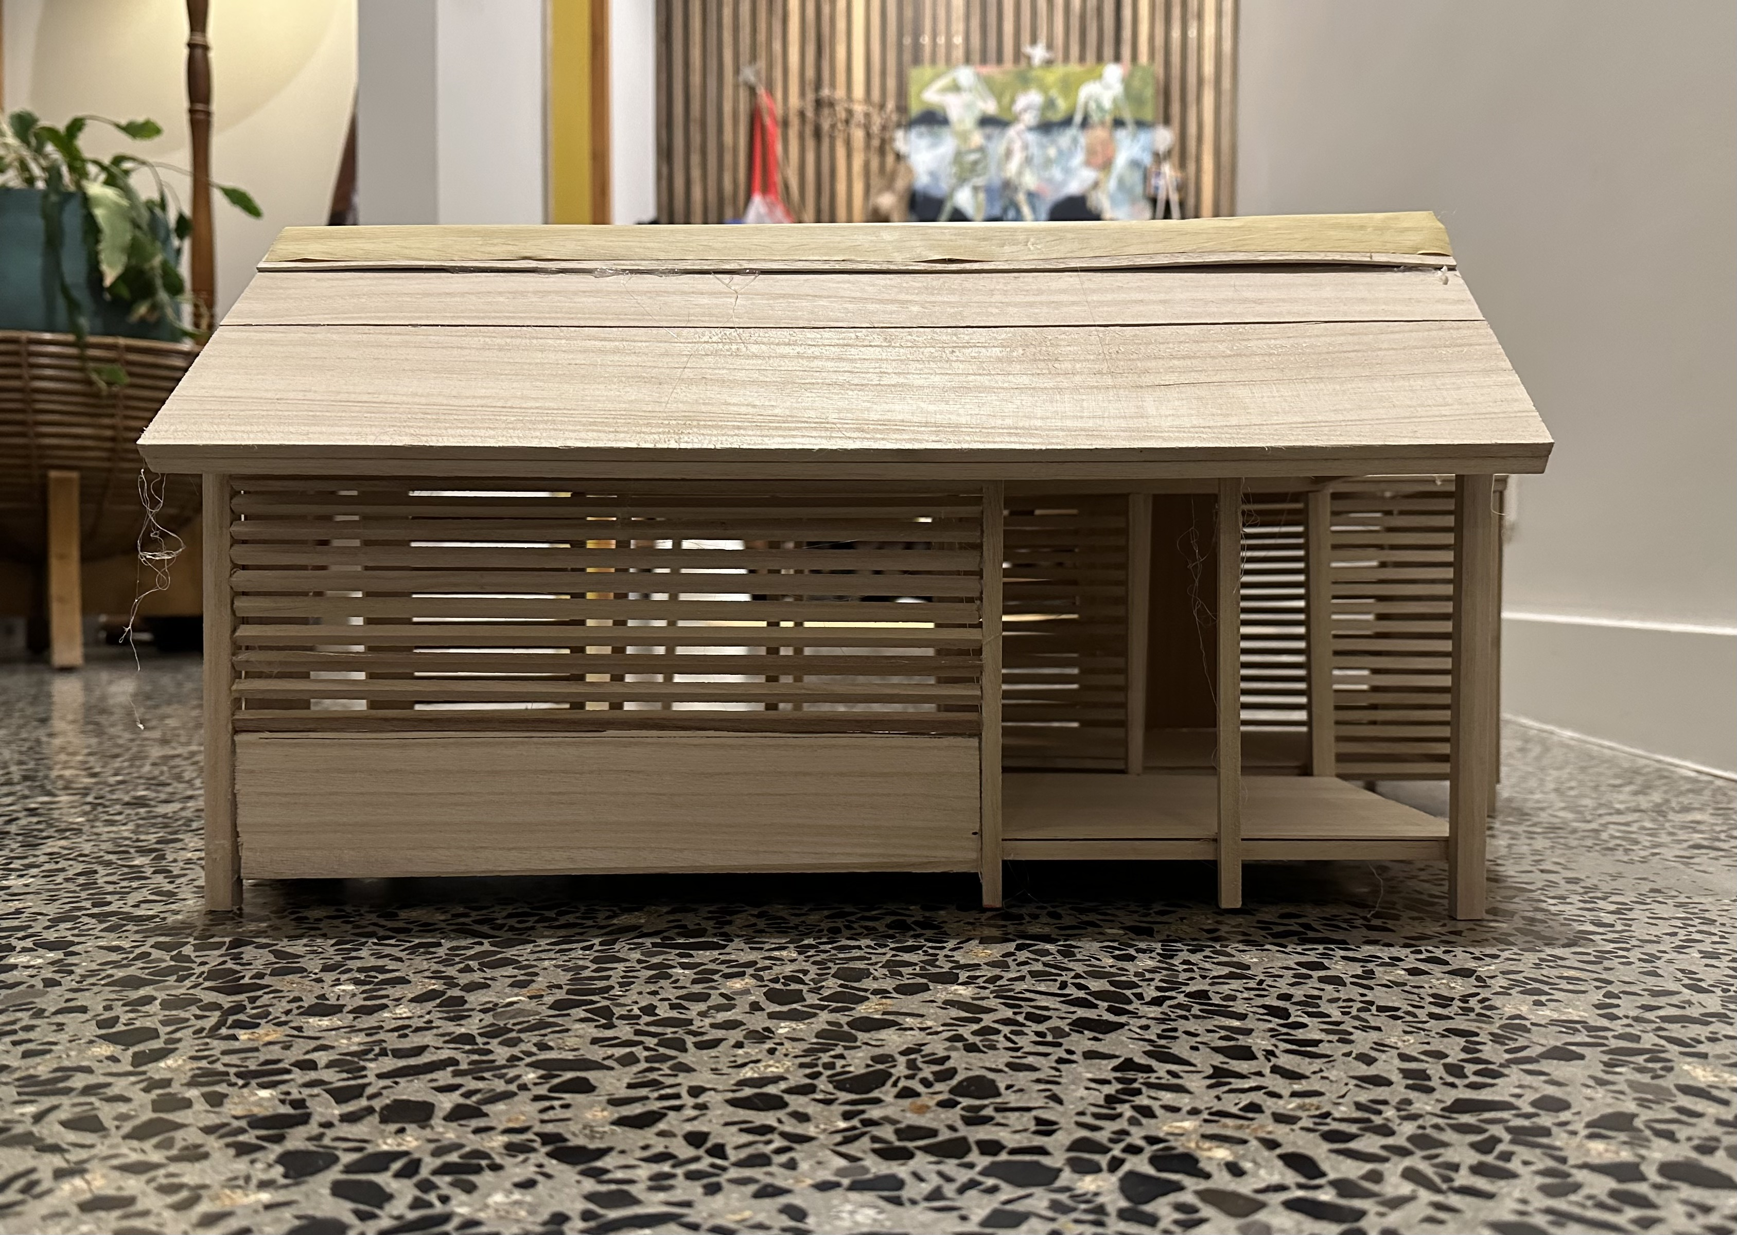
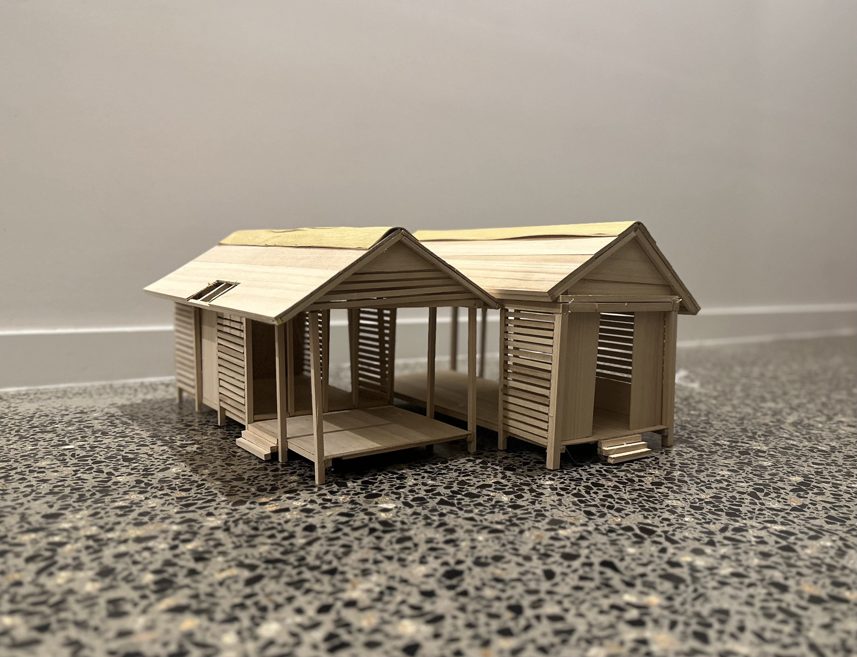
Marie Short House - Final Model (Fergus Shaw)

Slide 4
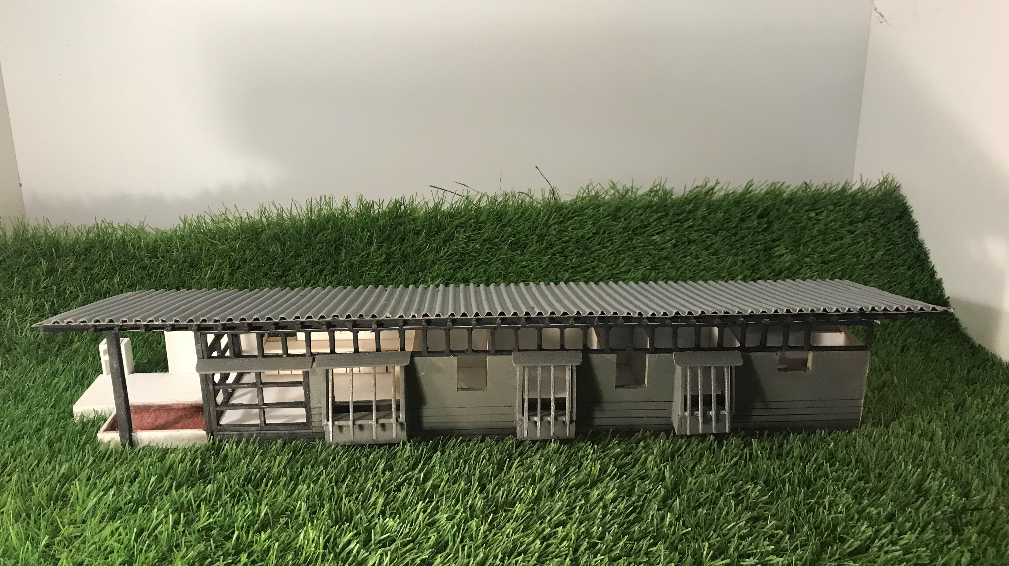
Walsh House Kangaroo valley NSW
Designed by Glenn Murcutt

Slide 5
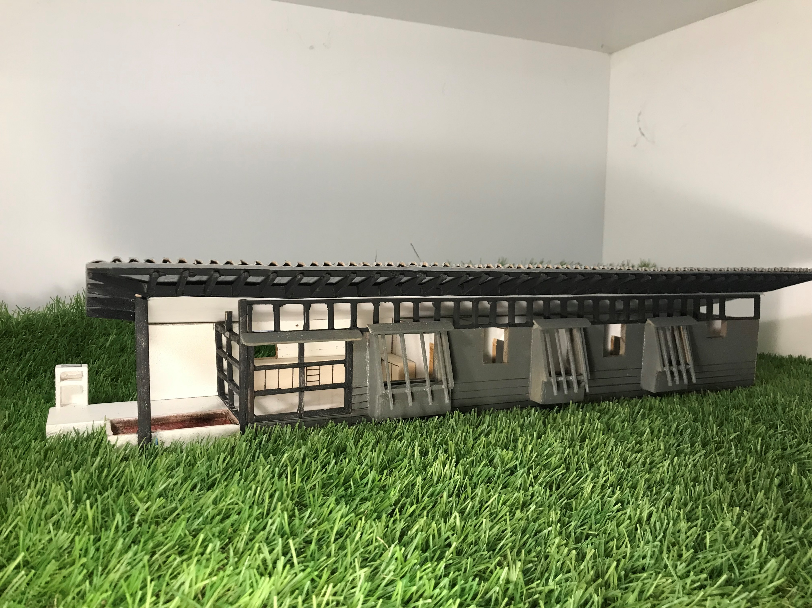

Slide 6
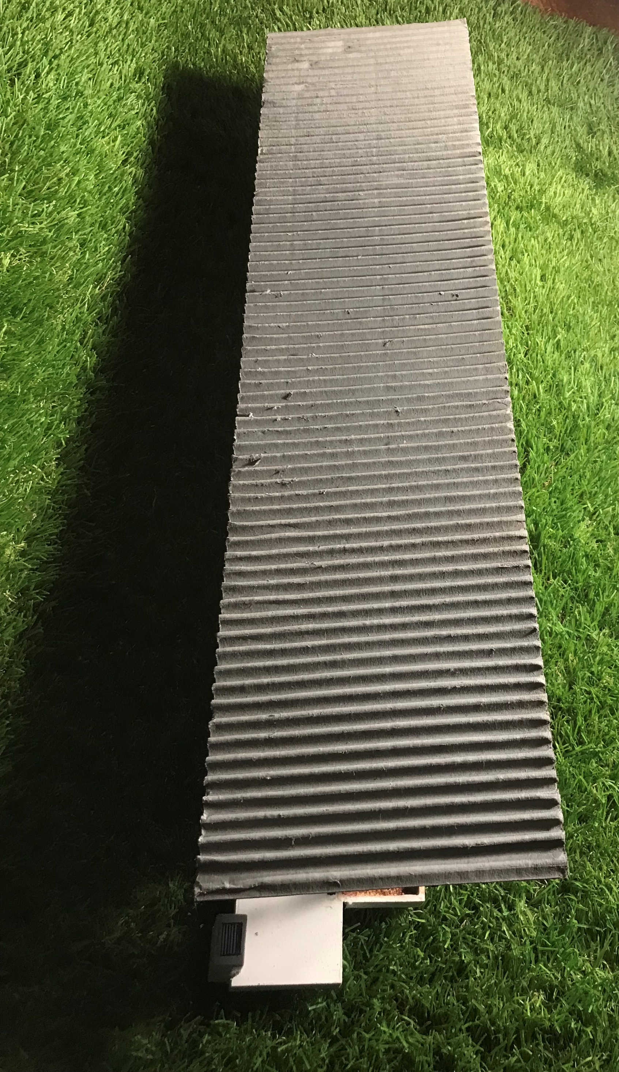

Slide 7
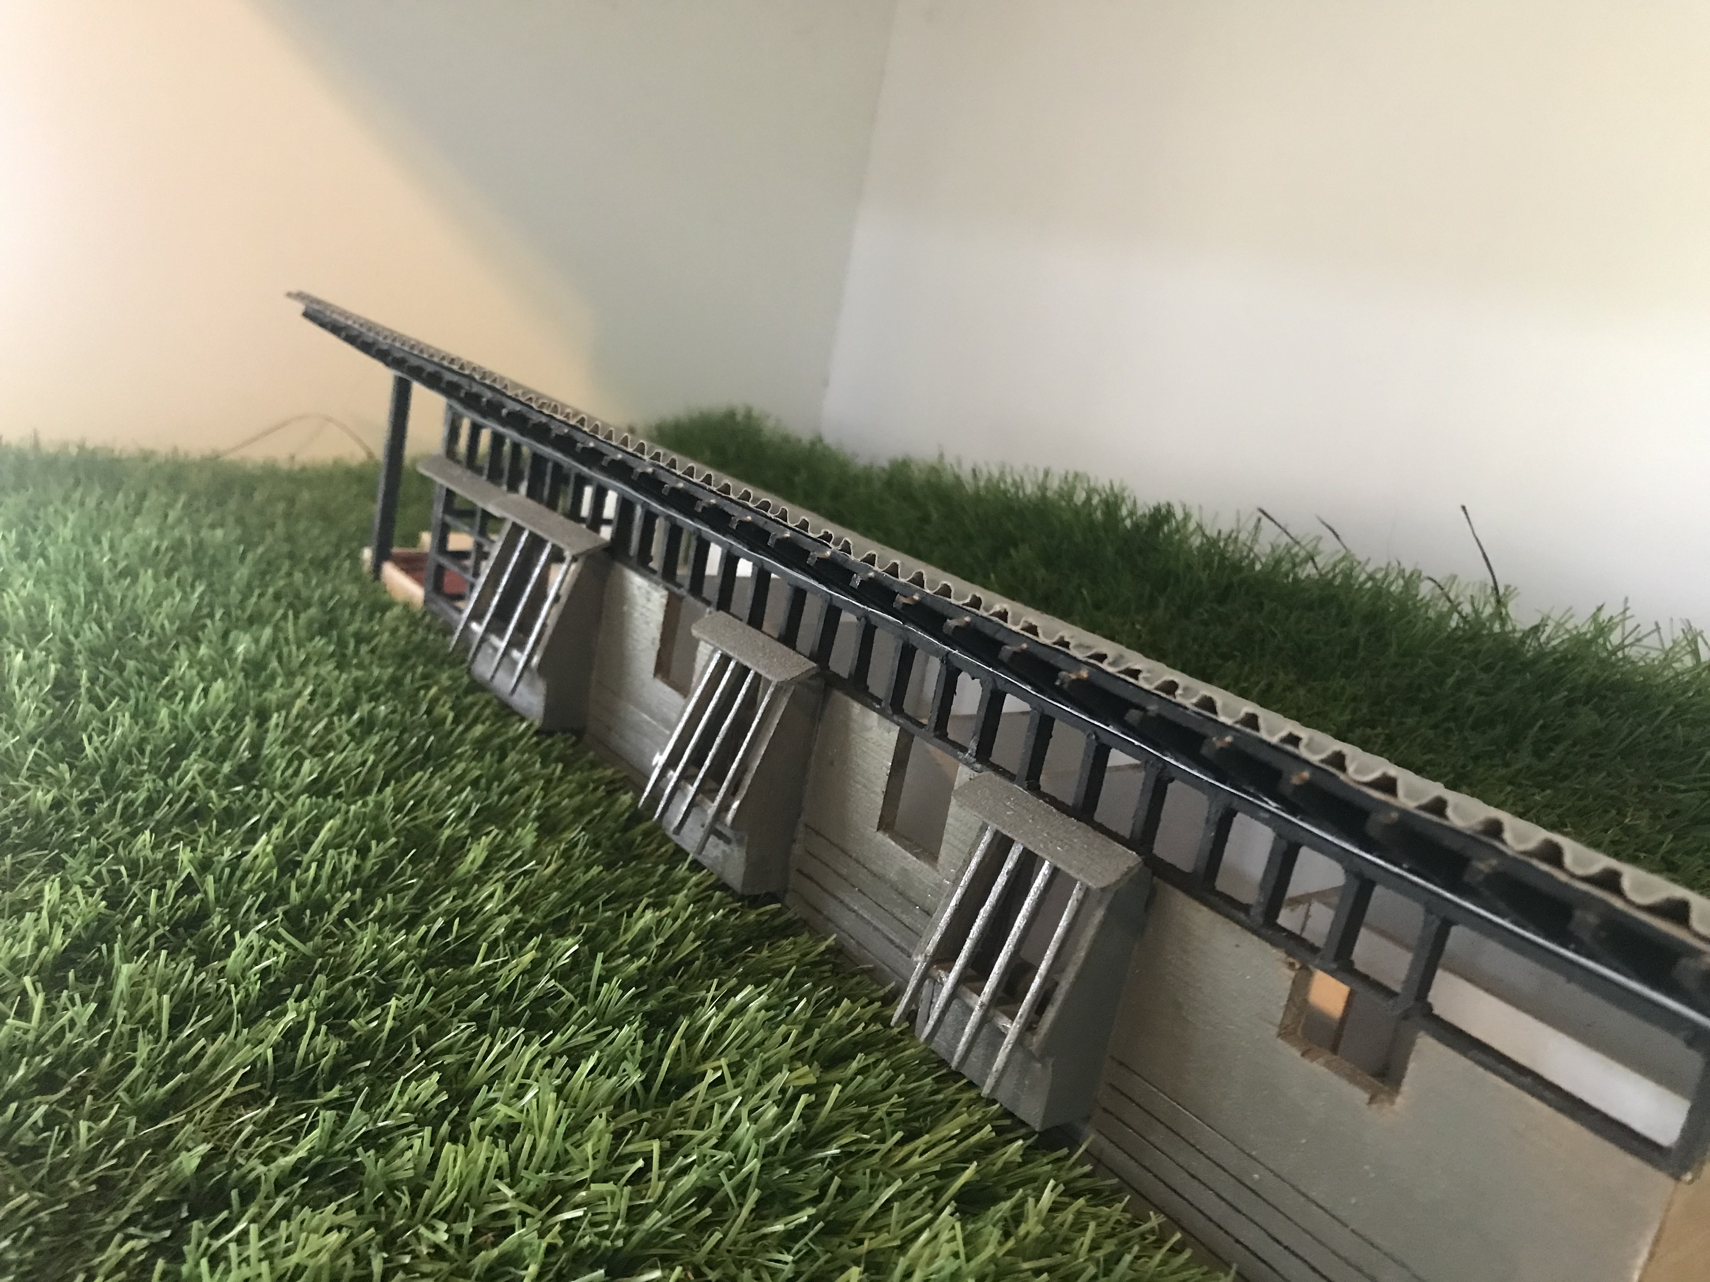

Slide 8
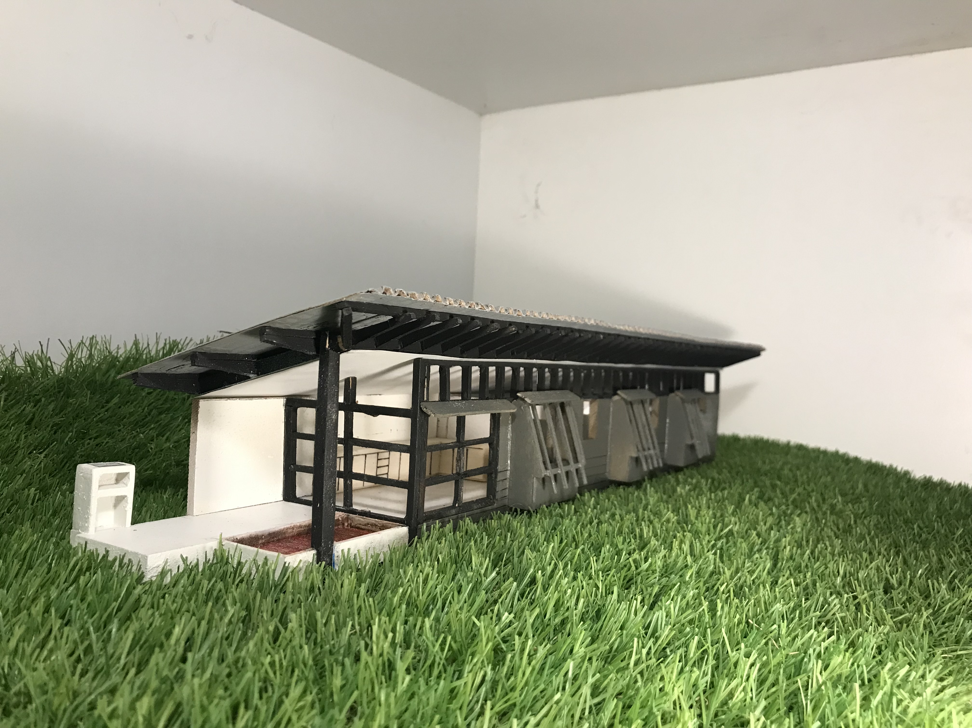

Slide 9
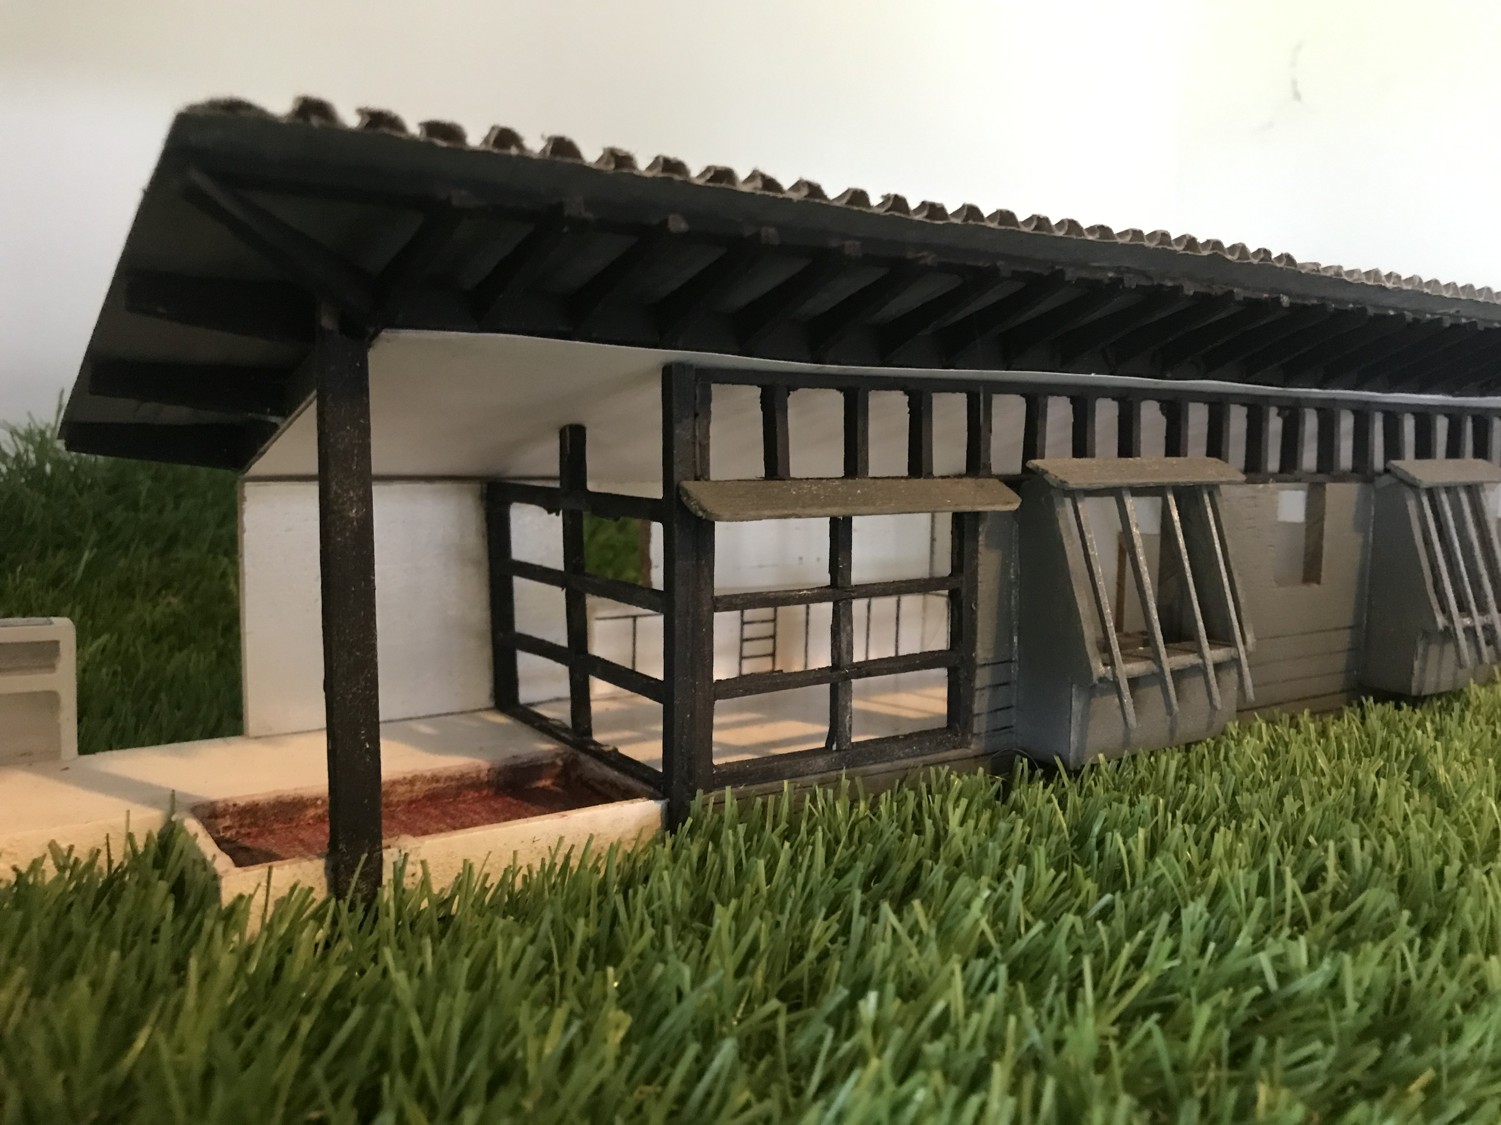

Slide 10
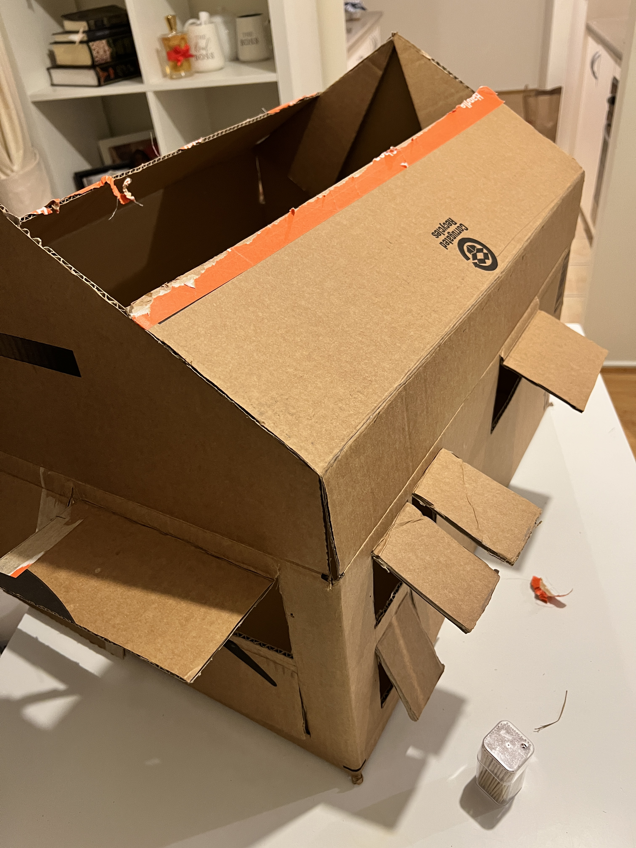
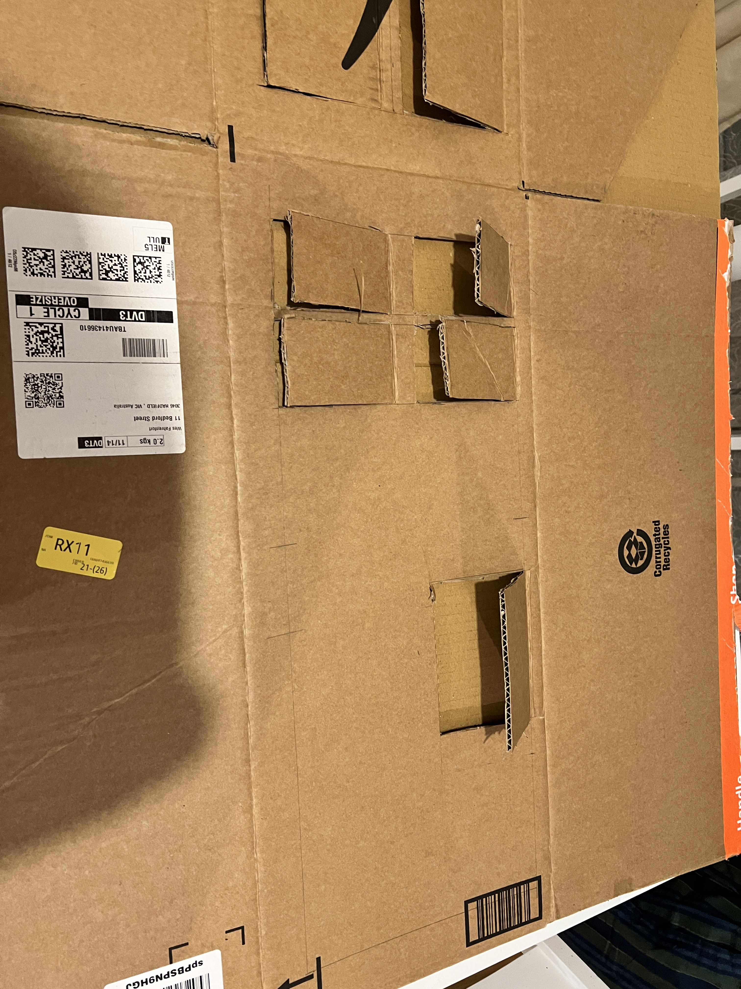
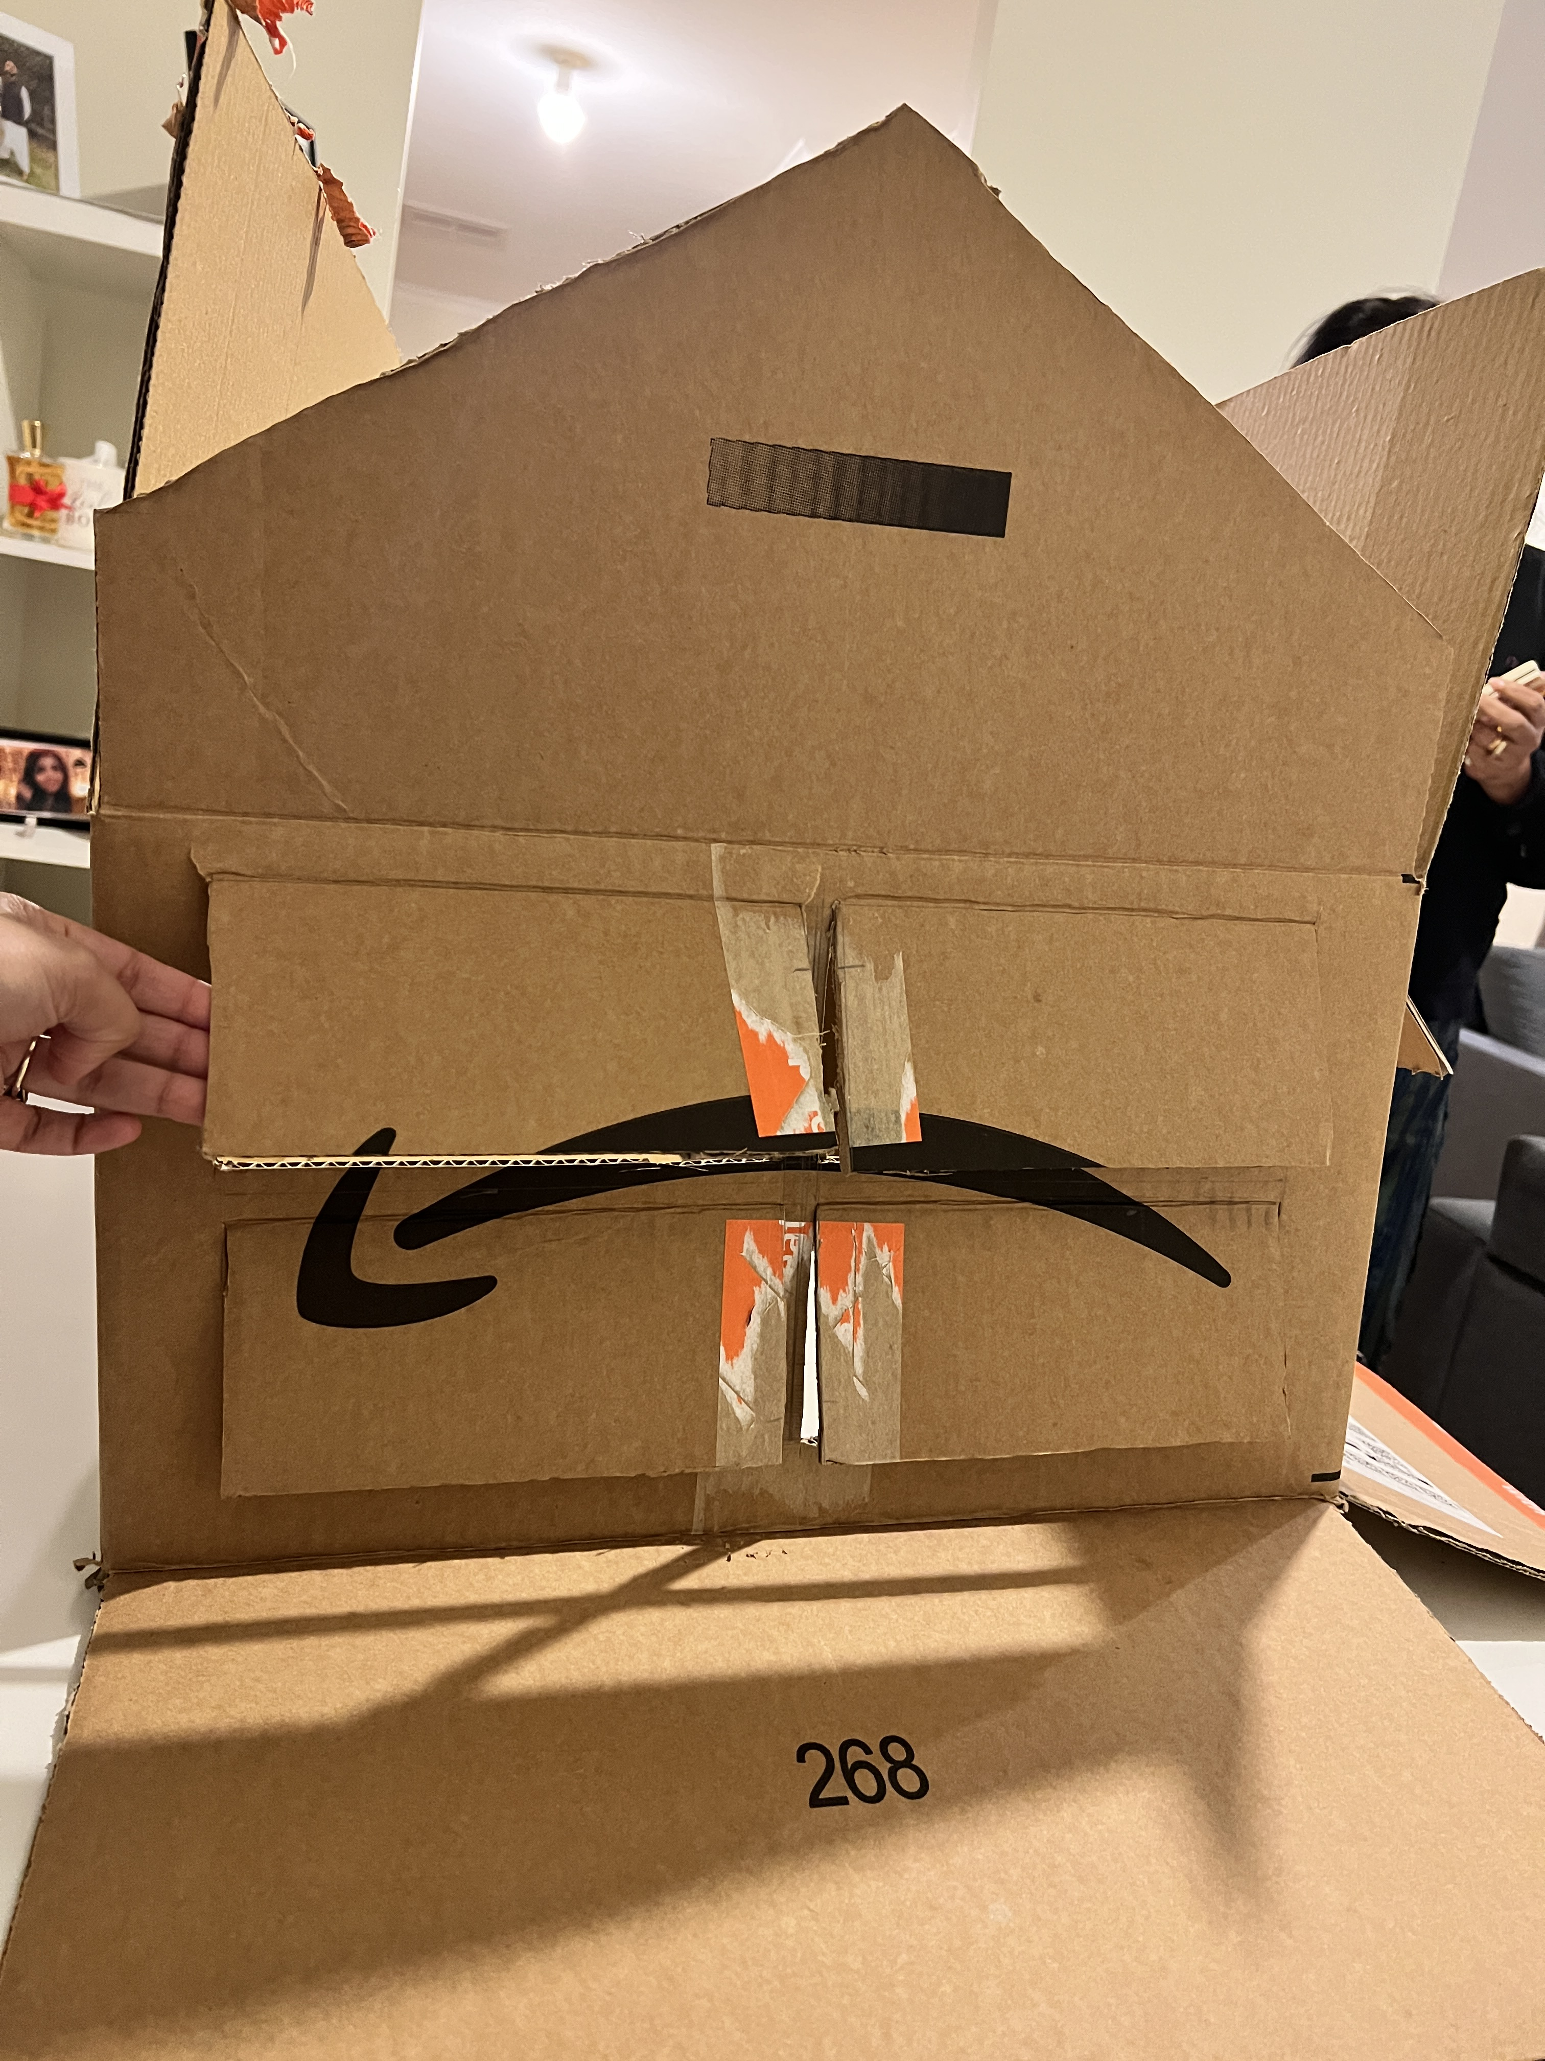
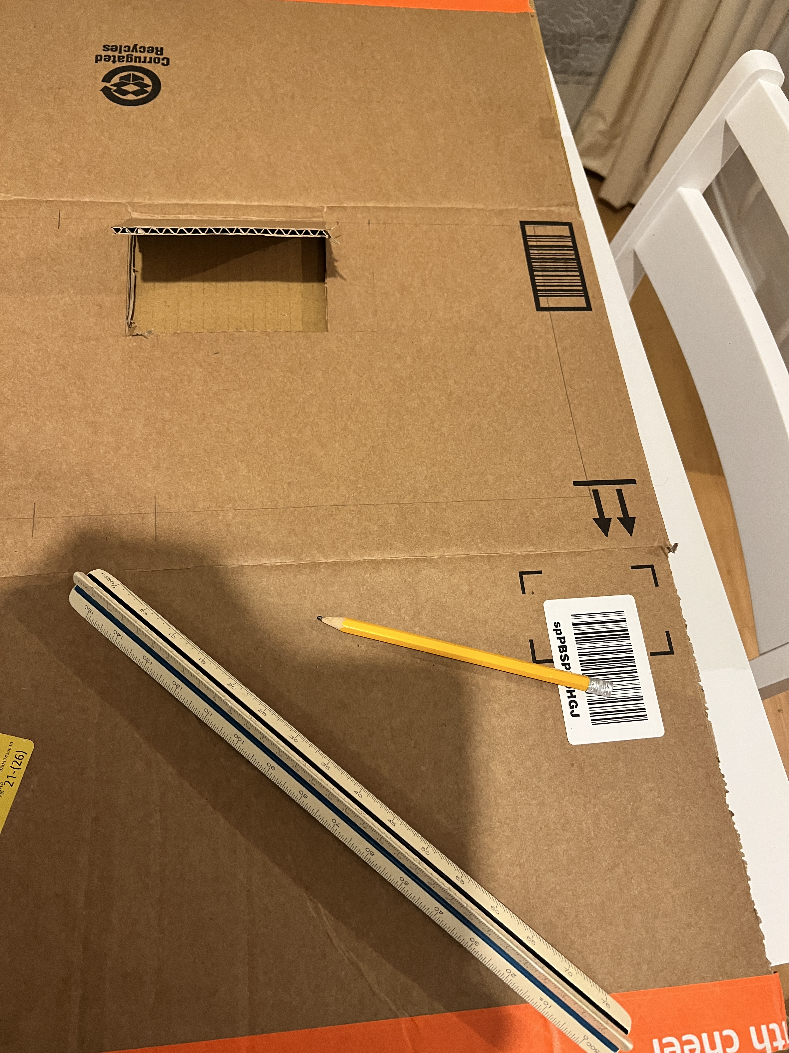
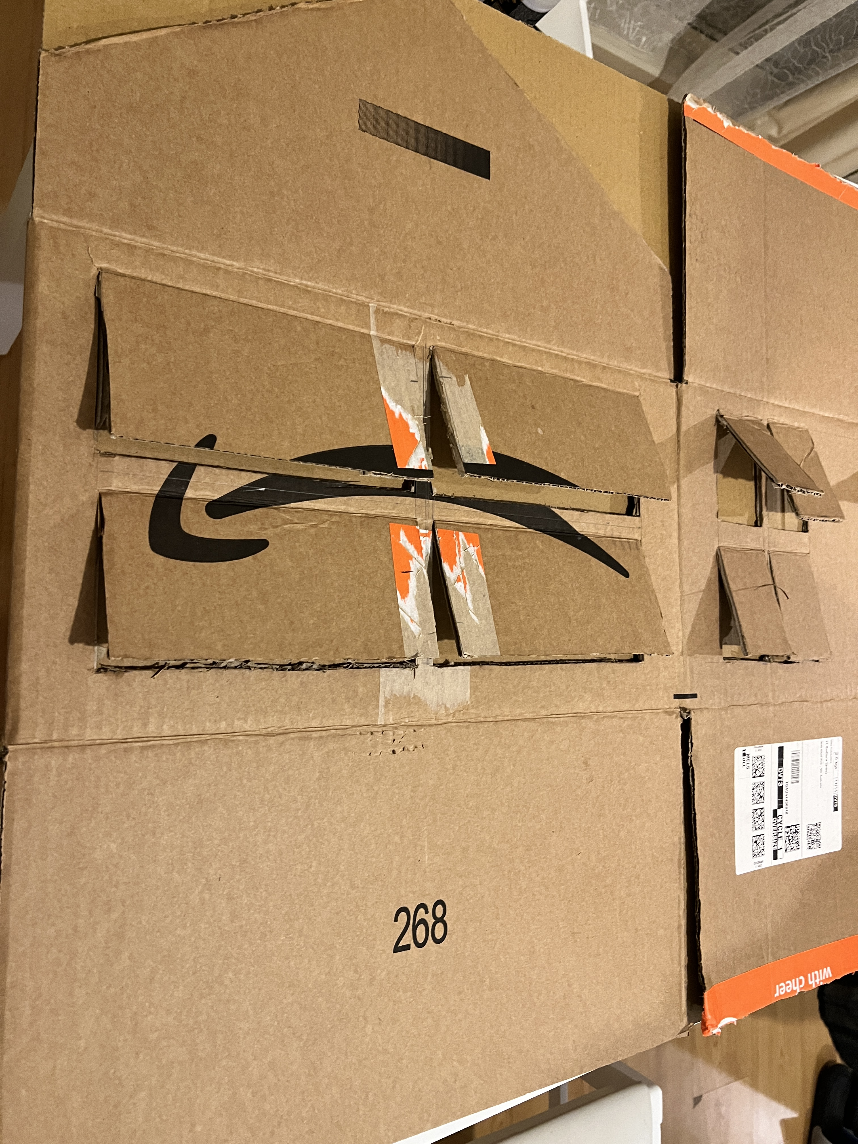
Marina-Alderton House - Process Model (Palwasha Saqib)
Steps Involved:
Cardboard box, Stanley knife, heavy duty glue, aluminum foil, tooth picks
All the windows and sections are cut separately and joined
3. The truss is made by separating layers of cardboard.
Chimneys and solar panels made from aluminum foil
The façade is spray painted to give actual color of the house
Studs made from cardboard as well

Slide 11
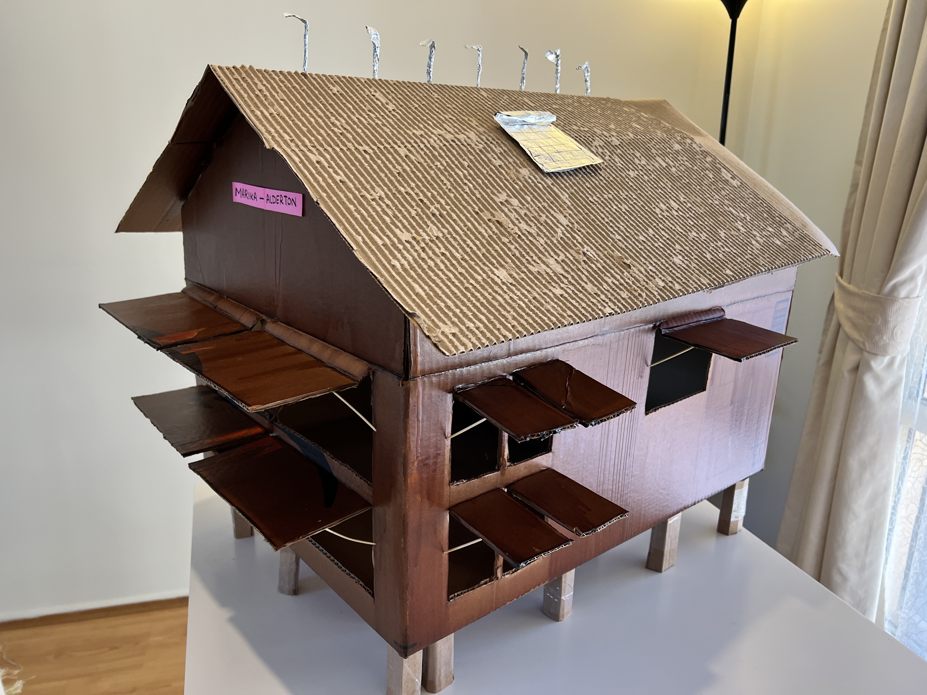
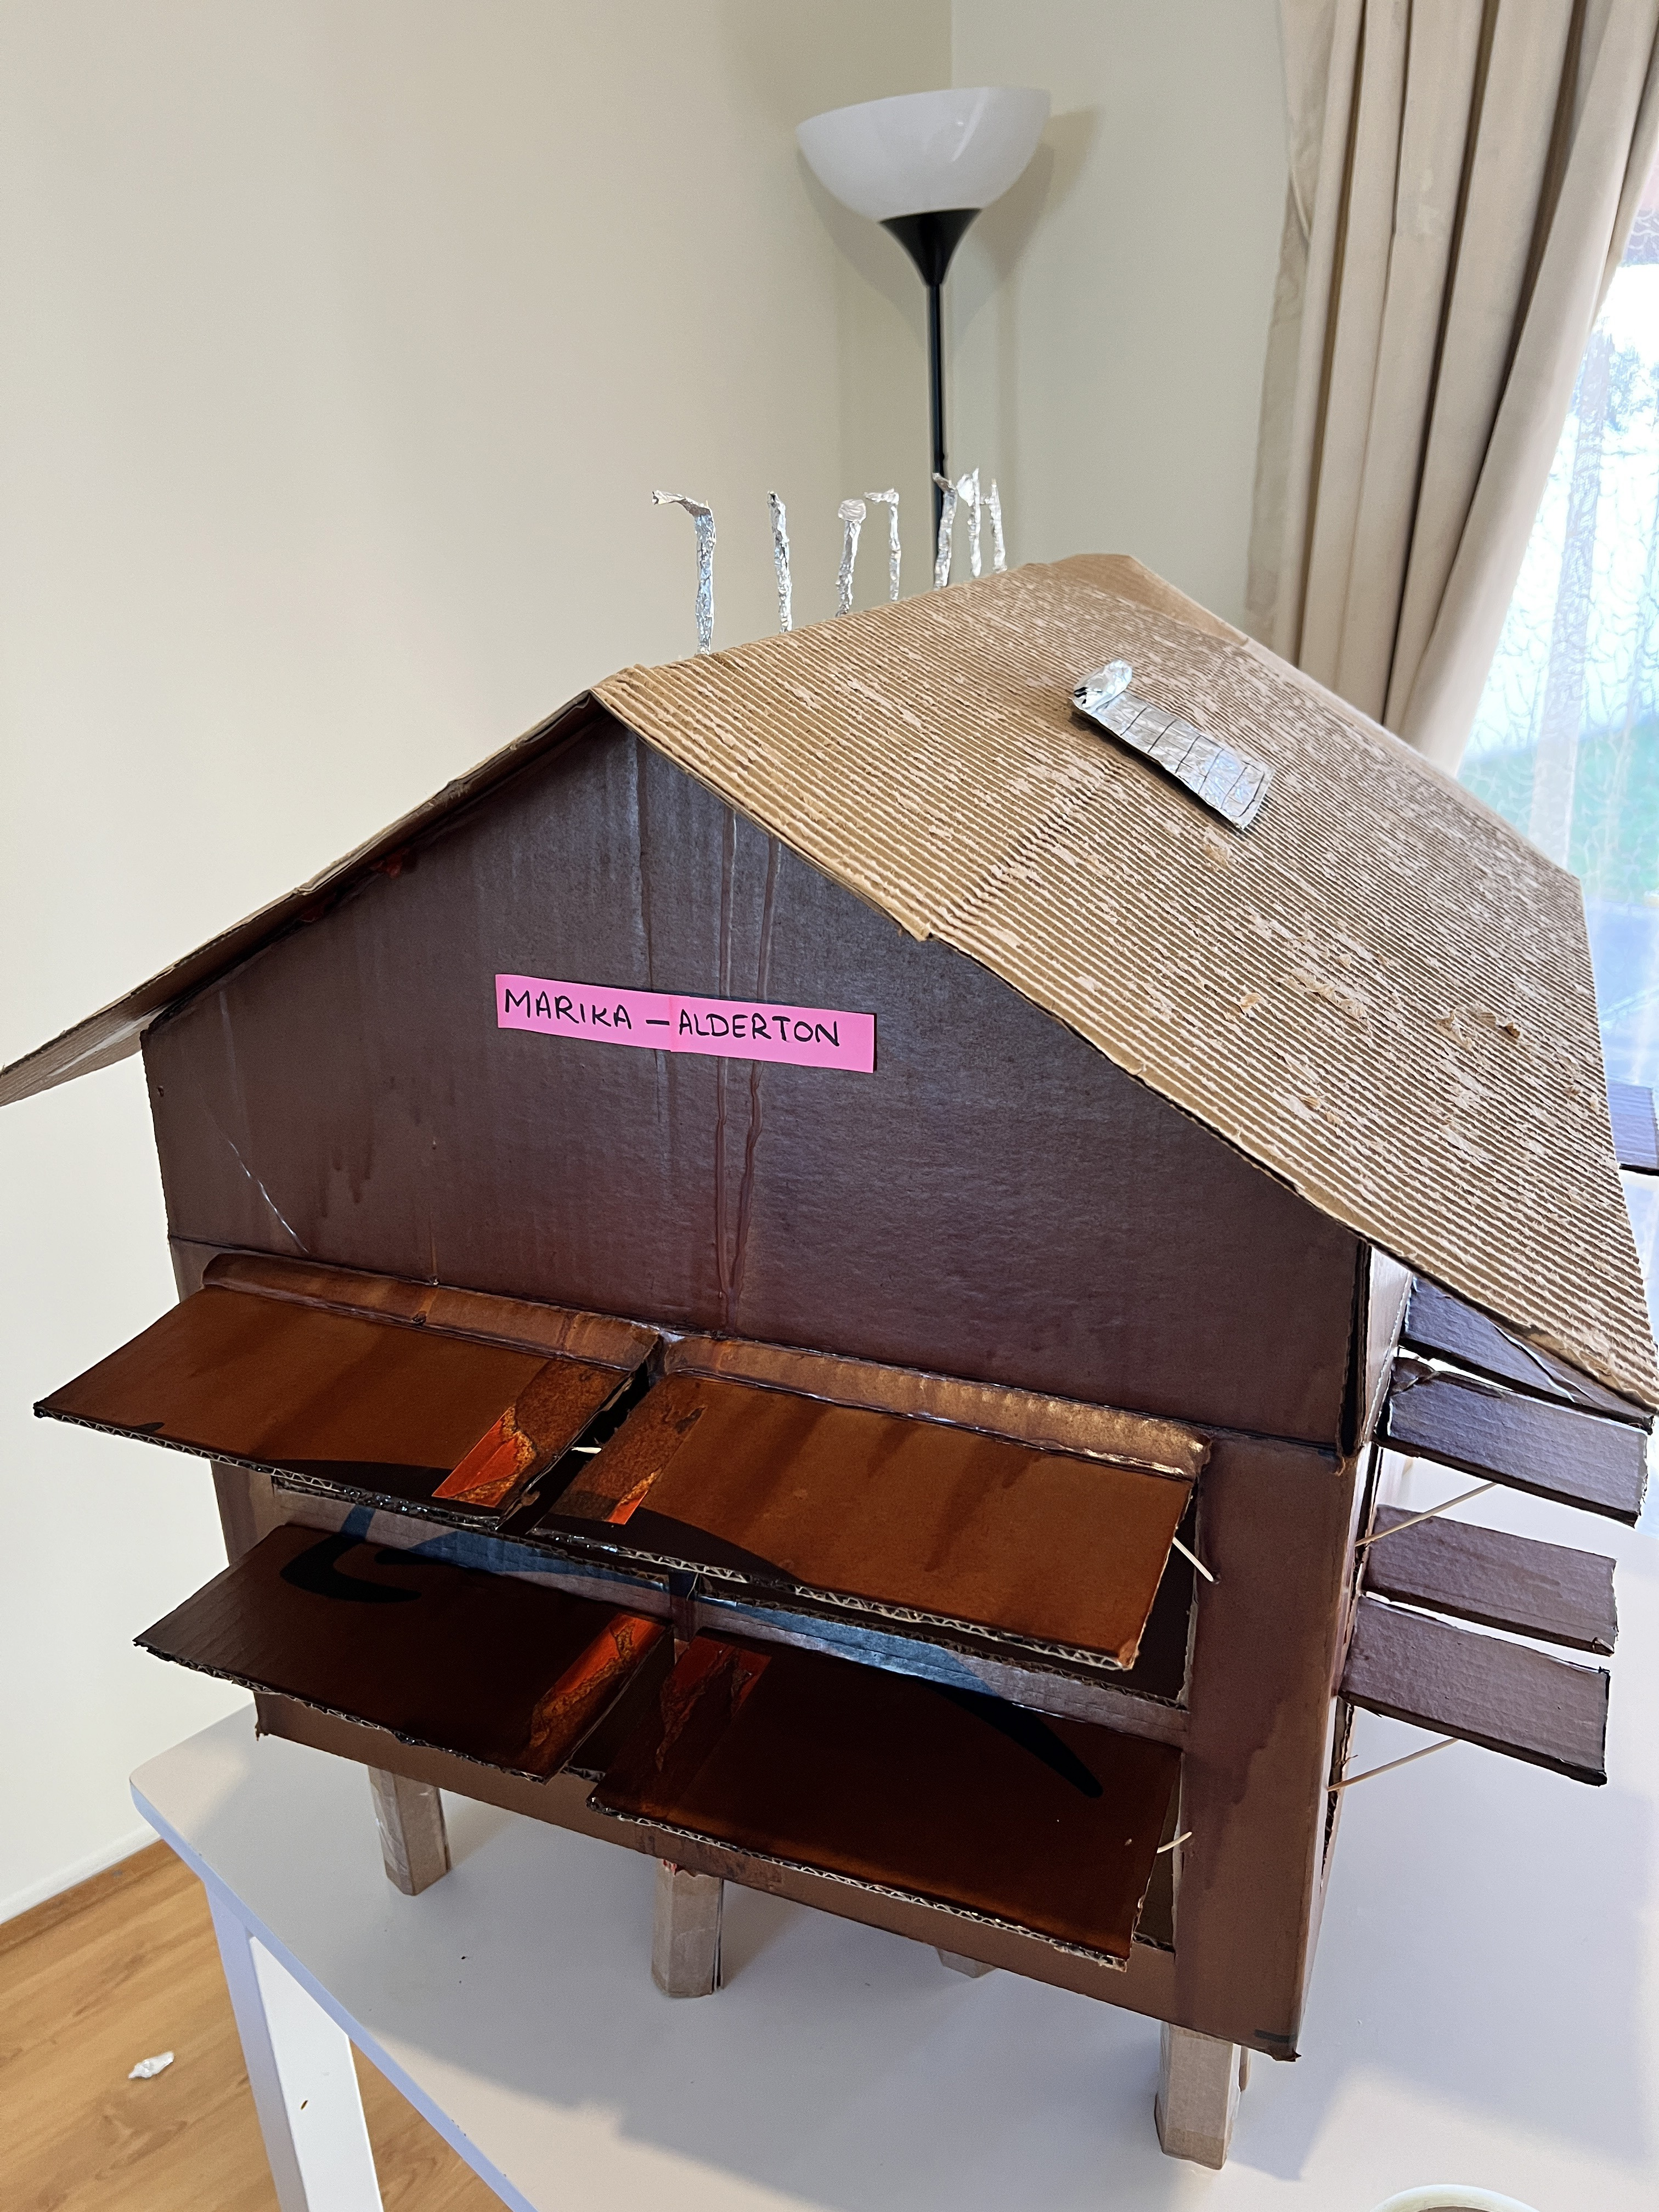
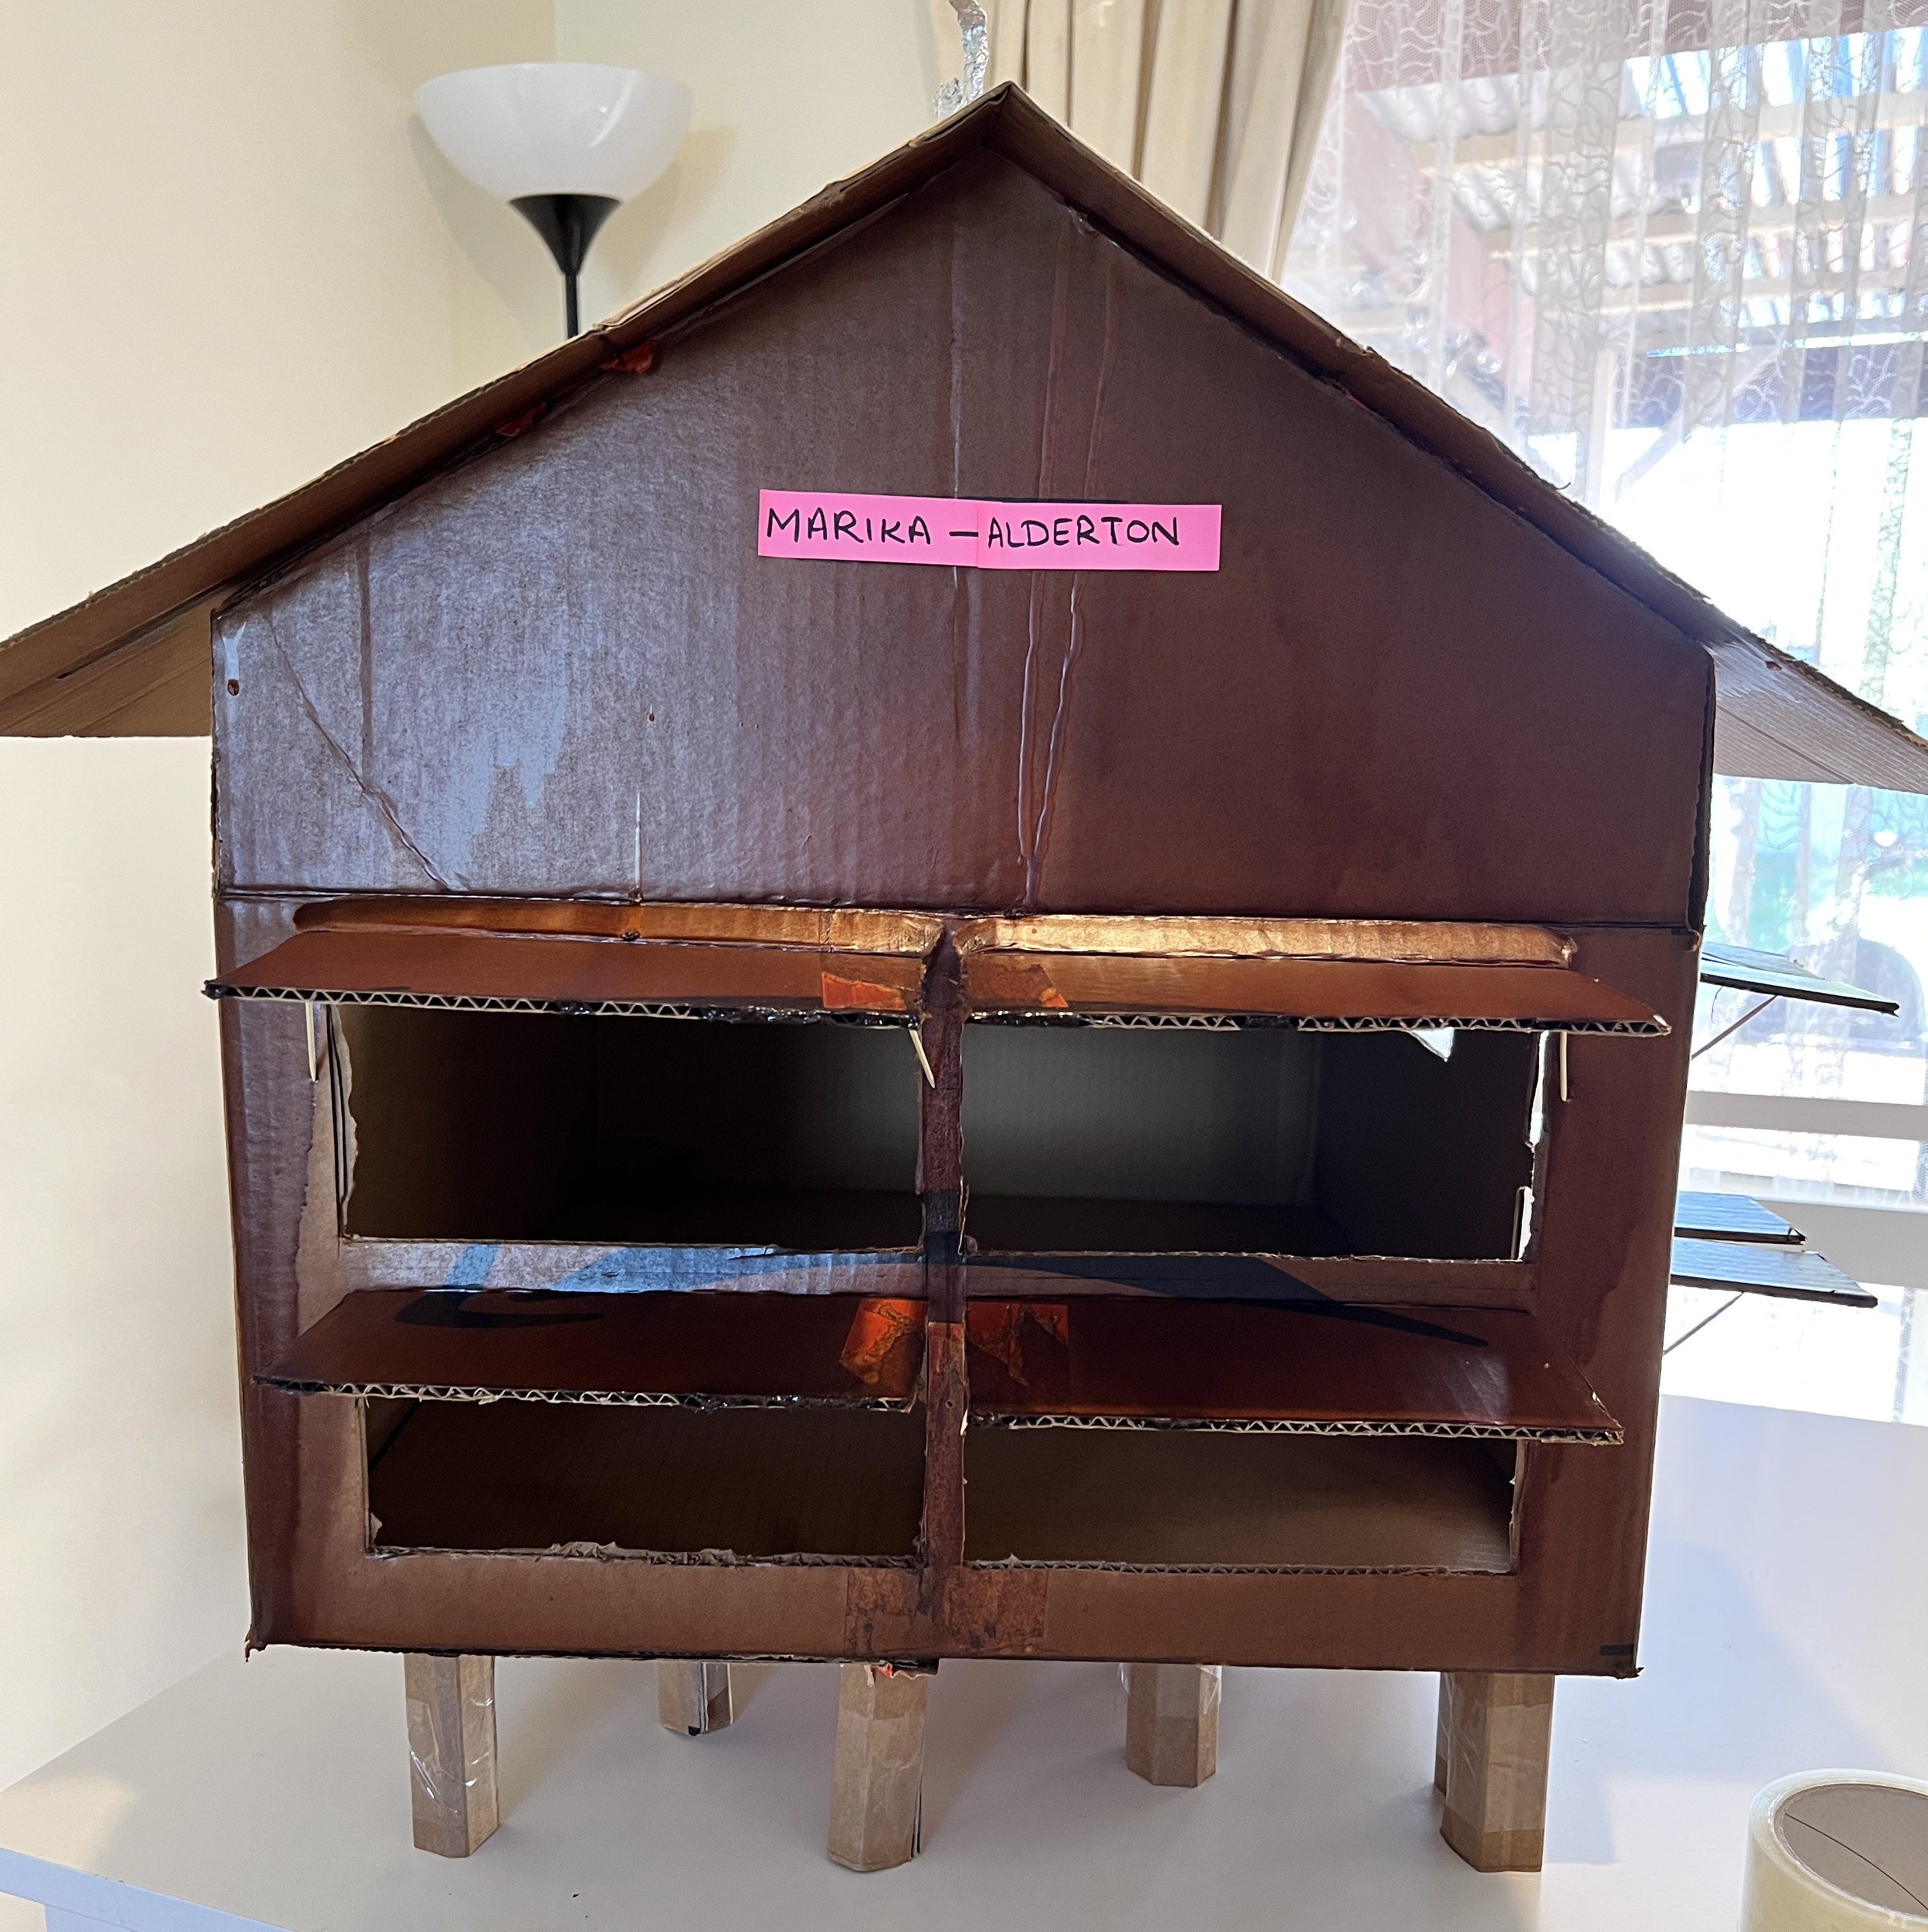
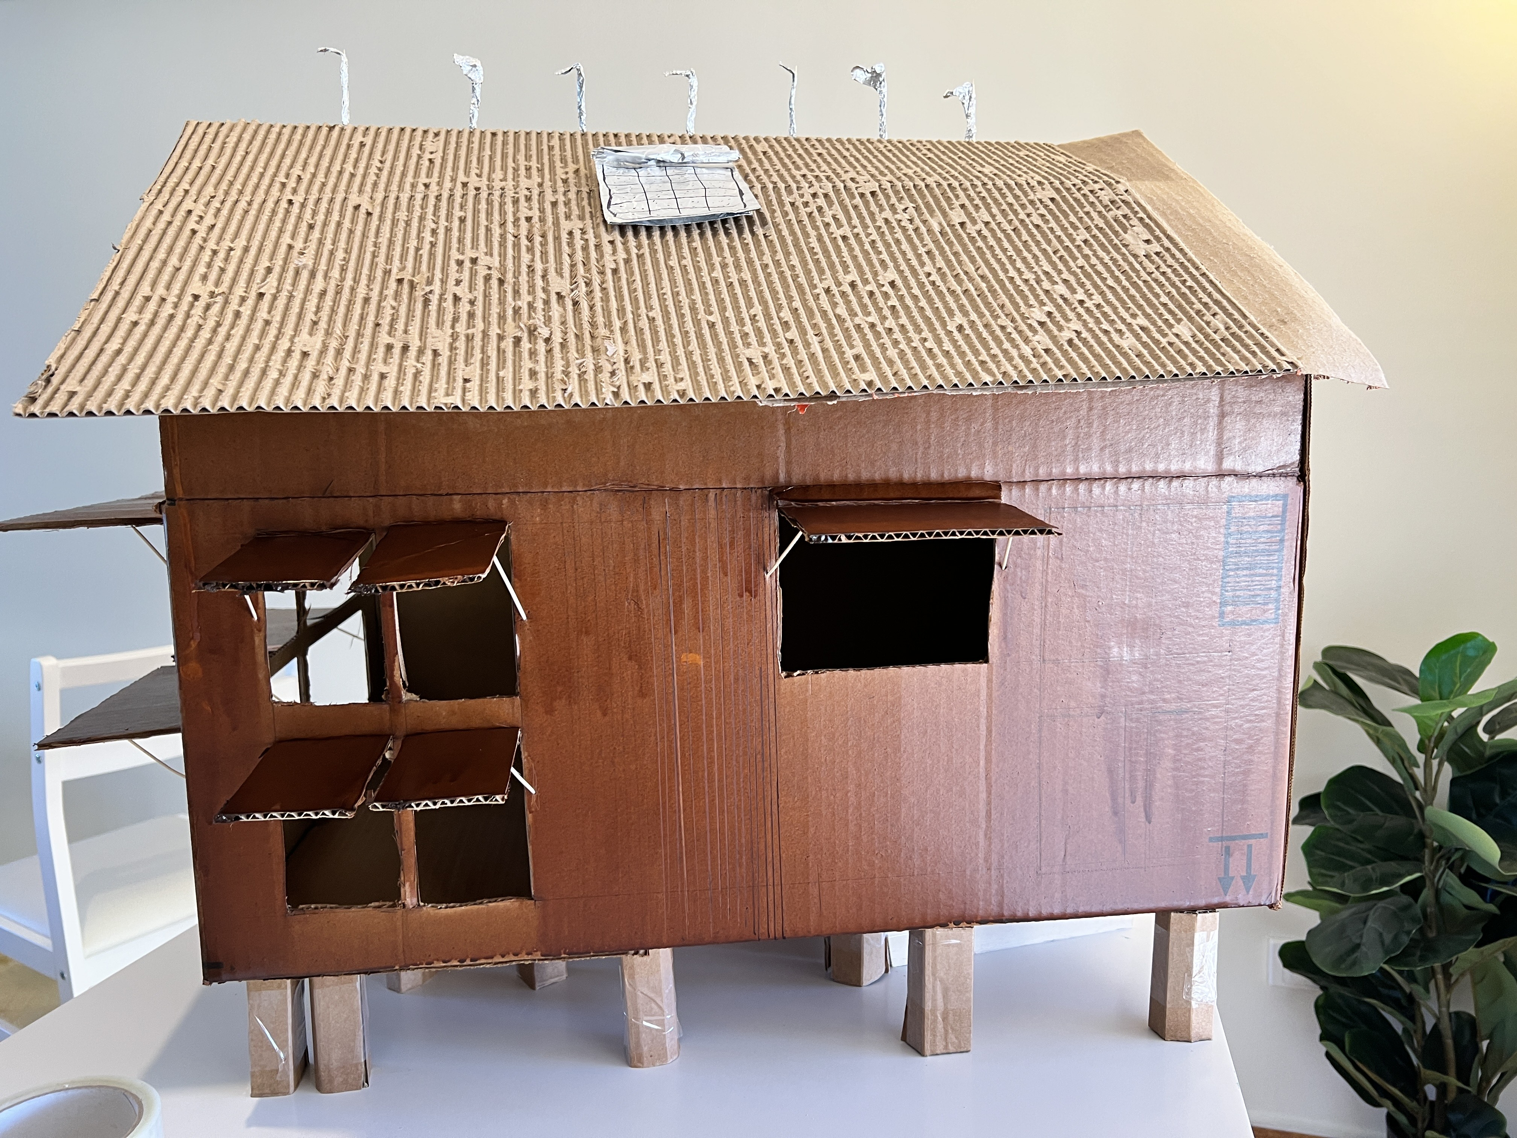
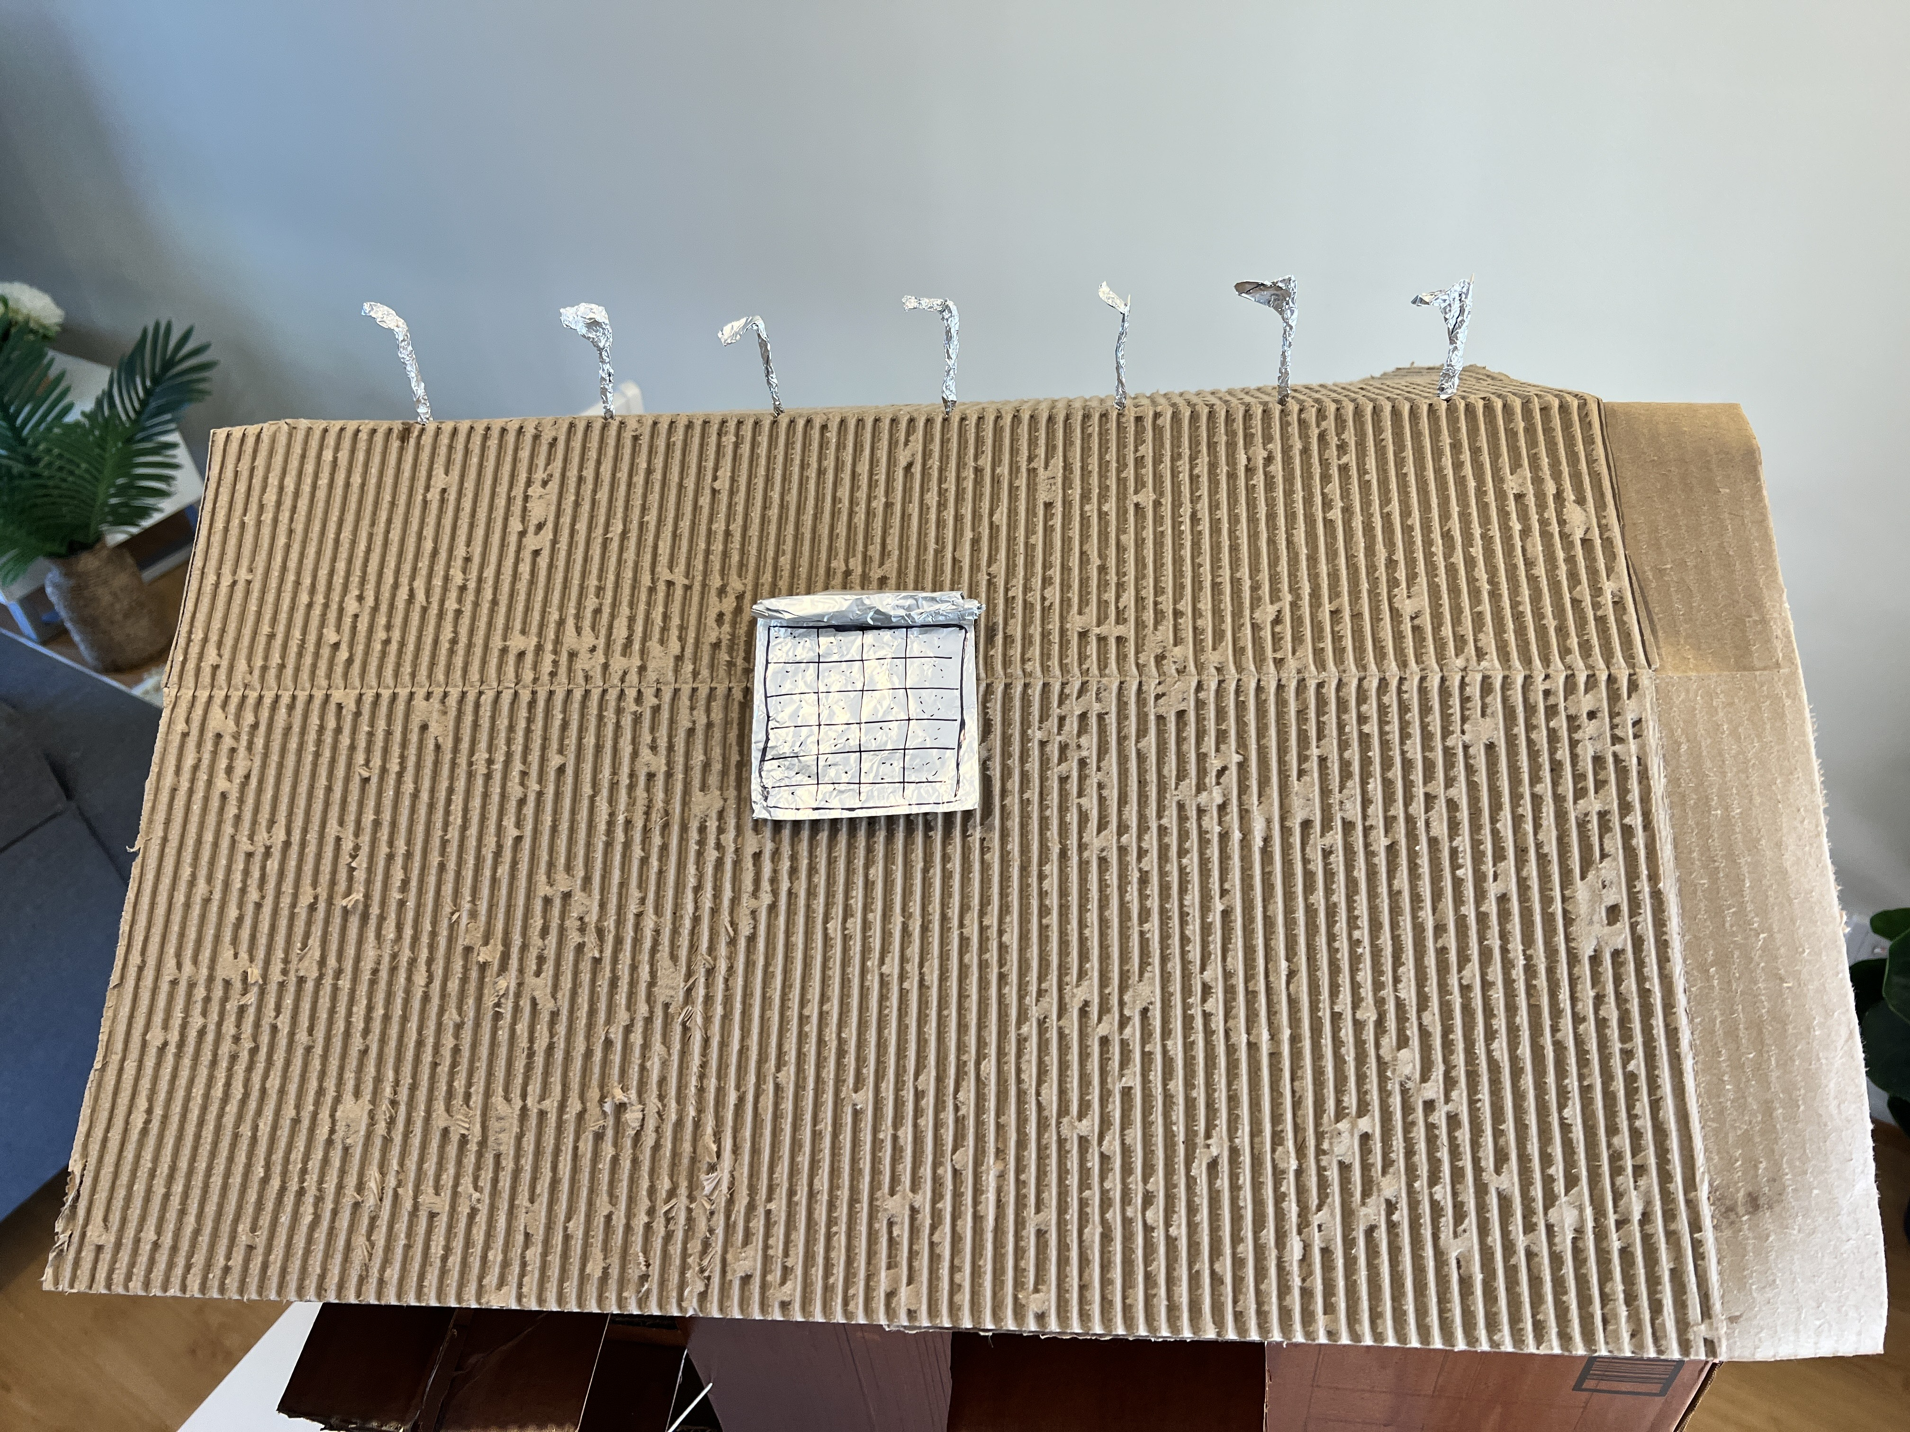
Marina – Alderton House - Final Model (Palwasha Saqib)

